Slide 1
Optimization-Based & Neural Information Ordering
Ling 573
Systems and Applications
May 7, 2020

Slide 2
Roadmap
Ordering as optimization
Neural information ordering

Slide 3
Ordering as Optimization
Given a set of sentences to order
Define a local pairwise coherence score b/t sentences
Compute a total order optimizing local distances
Can we do this efficiently?

Slide 4
Ordering as Optimization
Given a set of sentences to order
Define a local pairwise coherence score b/t sentences
Compute a total order optimizing local distances
Can we do this efficiently?
Optimal ordering of this type is equivalent to TSP
Traveling Salesperson Problem: Given a list of cities and distances between cities, find the shortest route that visits each city exactly once and returns to the origin city.

Slide 5
Ordering as Optimization
Given a set of sentences to order
Define a local pairwise coherence score b/t sentences
Compute a total order optimizing local distances
Can we do this efficiently?
Optimal ordering of this type is equivalent to TSP
Traveling Salesperson Problem: Given a list of cities and distances between cities, find the shortest route that visits each city exactly once and returns to the origin city.
TSP is NP-complete (NP-hard)

Slide 6
Ordering as TSP
Can we do this practically?
DUC Summaries were 250 words, so 6-10 sentences
10 sentences have how many possible orders

Slide 7
Ordering as TSP
Can we do this practically?
DUC summaries were 250 words, so 6-10 sentences
10 sentences have how many possible orders? O(n!)
Not impossible
Alternatively,

Slide 8
Ordering as TSP
Can we do this practically?
DUC summaries were 250 words, so 6-10 sentences
10 sentences have how many possible orders? O(n!)
Not impossible
Alternatively,
Use an approximation methods
Take the best of a sample

Slide 9
CLASSY 2006
Formulates ordering as TSP
Requires pairwise sentence distance measure

Slide 10
CLASSY 2006
Formulates ordering as TSP
Requires pairwise sentence distance measure
Term-based similarity: # of overlapping terms

Slide 11
CLASSY 2006
Formulates ordering as TSP
Requires pairwise sentence distance measure
Term-based similarity: # of overlapping terms
Document similarity:
Multiply by a weight if in the same document (there, 1.6)

Slide 12
CLASSY 2006
Formulates ordering as TSP
Requires pairwise sentence distance measure
Term-based similarity: # of overlapping terms
Document similarity:
Multiply by a weight if in the same document (there, 1.6)
Normalize to between 0 and 1 (sqrt of product of selfsim)
Make distance: subtract from 1

Slide 13
Practicalities of Ordering
Brute force: O(n!)

Slide 14
Practicalities of Ordering
Brute force: O(n!)
“there are only 3,628,800 ways to order 10 sentences plus a lead sentence, so exhaustive search is feasible.“ (Conroy)

Slide 15
Practicalities of Ordering
Brute force: O(n!)
“there are only 3,628,800 ways to order 10 sentences plus a lead sentence, so exhaustive search is feasible.“ (Conroy)
Still,..
Used sample set to pick best
Candidates:
Random
Single-swap changes from good candidates

Slide 16
Practicalities of Ordering
Brute force: O(n!)
“there are only 3,628,800 ways to order 10 sentences plus a lead sentence, so exhaustive search is feasible.“ (Conroy)
Still,..
Used sample set to pick best
Candidates:
Random
Single-swap changes from good candidates
50K enough to consistently generate minimum cost order

Slide 17
Neural Sentence Ordering
Strategies:
Local coherence models
Pairwise Ranking (Chen et al, ‘16); Window net (Li, Hovy ‘14)
Hierarchical RNN models
Build paragraph model w/LSTM over word, sentence models
Gong et al, ‘16; Logesawaran et al ’18
“Deep Attentive Sentence Ordering Network”
Combines paragraph models with attention mech

Slide 18
AttOrderNet
Basic approach:
Use LSTMs to build sentence vectors
Use LSTMs+Attention for rep. of paragraphs
Hierarchical representation
Generate ordered sentence output
Evaluated on sentence ordering and pairwise ranking

Slide 19
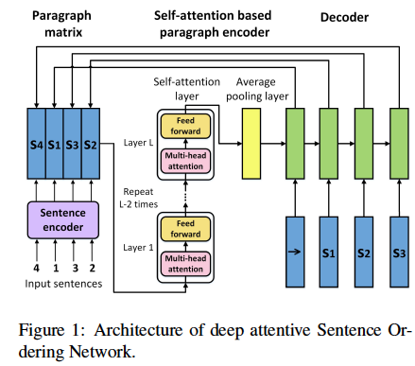
Architecture
Cui et al, ‘18

Slide 20
Problem Structure & Model
Find highest coherence ordering over set of sents:
P(o*|s) > P(o|s), over all possible orderings
Sentence encoding:
Words are represented using pretrained embeddings
100 dim Glove vectors
Vector representation of sentence
Bi-directional LSTM: forward and backward represent’ns
Concatenation of final forward and back hidden states

Slide 21
Paragraph Representation
Sentences are combined into initial matrix E⁰
Sequence of attention, feed-forward layers applied
Computes and weights by relevance scores b/t sents
Computes final vector representation of para
Average over rows of final paragraph matrix
V = 1/nΣ_{i=1:n}e^{Li}

Slide 22
Decoding & Training
Uses LSTM to produce distribution over sentences
Initial state is paragraph representation vector
Input is previous sentence
Training: embedding of true sentence
Testing: embedding of predicted sentence
Performs beam search to order sentences
Training instances?

Slide 23
Decoding & Training
Uses LSTM to produce distribution over sentences
Initial state is paragraph representation vector
Input is previous sentence
Training: embedding of true sentence
Testing: embedding of predicted sentence
Performs beam search to order sentences
Training instances:
Random permutation of document sentences
per epoch

Slide 24
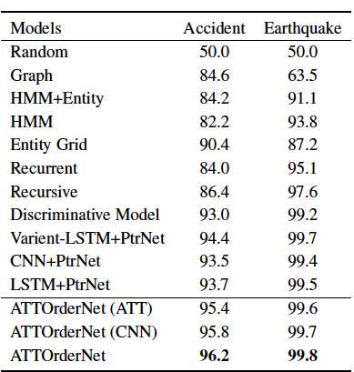
Pairwise Ranking
Task: Rank original clean document higher than permutation

Slide 25
Conclusions
Many cues to ordering:
Temporal, coherence, cohesion
Chronology, topic structure, entity transitions, similarity
Strategies:
Heuristic, machine learned; supervised, unsupervised
Incremental build-up versus generate & rank
Neural paragraph models
Issues:
Domain independence, semantic similarity, reference

Slide 26
Content Realization: Linguistic Quality
Ling 573
Systems and Applications
May 7, 2020

Slide 27
Roadmap
Content realization in summarization
Goals
Broad approaches
Readability and linguistic quality:
Corpus study and analysis
Automatic evaluation
Improvements for MDS

Slide 28
Goals of Content Realization
Abstractive summaries:

Slide 29
Goals of Content Realization
Abstractive summaries:
Content selection works over concepts
Need to produce important concepts in fluent NL

Slide 30
Goals of Content Realization
Abstractive summaries:
Content selection works over concepts
Need to produce important concepts in fluent NL
Extractive summaries:
Already working with NL sentences

Slide 31
Goals of Content Realization
Abstractive summaries:
Content selection works over concepts
Need to produce important concepts in fluent NL
Extractive summaries:
Already working with NL sentences
Extreme compression

Slide 32
Goals of Content Realization
Abstractive summaries:
Content selection works over concepts
Need to produce important concepts in fluent NL
Extractive summaries:
Already working with NL sentences
Extreme compression: e.g 60 byte summaries: headlines
Increase information:

Slide 33
Goals of Content Realization
Abstractive summaries:
Content selection works over concepts
Need to produce important concepts in fluent NL
Extractive summaries:
Already working with NL sentences
Extreme compression: e.g 60 byte summaries: headlines
Increase information:
Remove verbose, unnecessary content
More space left for new information
Increase readability, fluency, linguistic quality

Slide 34
Goals of Content Realization
Abstractive summaries:
Content selection works over concepts
Need to produce important concepts in fluent NL
Extractive summaries:
Already working with NL sentences
Extreme compression: e.g 60 byte summaries: headlines
Increase information:
Remove verbose, unnecessary content
More space left for new information
Increase readability, fluency, linguistic quality
Present content from multiple docs, non-adjacent sents

Slide 35
Goals of Content Realization
Abstractive summaries:
Content selection works over concepts
Need to produce important concepts in fluent NL
Extractive summaries:
Already working with NL sentences
Extreme compression: e.g 60 byte summaries: headlines
Increase information:
Remove verbose, unnecessary content
More space left for new information
Increase readability, fluency, linguistic quality
Present content from multiple docs, non-adjacent sents
Improve content scoring

Slide 36
Goals of Content Realization
Abstractive summaries:
Content selection works over concepts
Need to produce important concepts in fluent NL
Extractive summaries:
Already working with NL sentences
Extreme compression: e.g 60 byte summaries: headlines
Increase information:
Remove verbose, unnecessary content
More space left for new information
Increase readability, fluency, linguistic quality
Present content from multiple docs, non-adjacent sents
Improve content scoring
Remove distractors, boost scores: i.e. % signature terms in doc

Slide 37
Broad Approaches
Abstractive summaries:
Complex Q-A: template-based methods
More generally: full NLG: concept-to-text

Slide 38
Broad Approaches
Abstractive summaries:
Complex Q-A: template-based methods
More generally: full NLG: concept-to-text
Extractive summaries:
Sentence compression:
Remove “unnecessary” phrases:
Information? Readability?

Slide 39
Broad Approaches
Abstractive summaries:
Complex Q-A: template-based methods
More generally: full NLG: concept-to-text
Extractive summaries:
Sentence compression:
Remove “unnecessary” phrases:
Information? Readability?
Sentence reformulation:
Reference handling
Information? Readability?

Slide 40
Broad Approaches
Abstractive summaries:
Complex Q-A: template-based methods
More generally: full NLG: concept-to-text
Extractive summaries:
Sentence compression:
Remove “unnecessary” phrases:
Information? Readability?
Sentence reformulation:
Reference handling
Information? Readability?
Sentence fusion: Merge content from multiple sents

Slide 41
Linguistic Quality

Slide 42
Evaluation
Shared tasks:
Take content as primary evaluation measure
ROUGE, Pyramid, (manual) Responsiveness
Linguistic quality also part of formal evaluation

Slide 43
Evaluation
Shared tasks:
Take content as primary evaluation measure
ROUGE, Pyramid, (manual) Responsiveness
Linguistic quality also part of formal evaluation
TAC “Readability”:
Scored manually on 5-point Likert scale
Aims to capture readability, fluency
Independent of summary content

Slide 44
What is “Readability”?
According to TAC,
Assessors consider (and rate 1-5) each of:
Grammaticality:
No fragments, datelines, ill-formed sentences, etc

Slide 45
What is “Readability”?
According to TAC,
Assessors consider (and rate 1-5) each of:
Grammaticality:
No fragments, datelines, ill-formed sentences, etc
Non-redundancy:
No unnecessary repetition: includes content, sentences, or full NPs when pronoun is better

Slide 46
What is “Readability”?
According to TAC,
Assessors consider (and rate 1-5) each of:
Grammaticality:
No fragments, datelines, ill-formed sentences, etc
Non-redundancy:
No unnecessary repetition: includes content, sentences, or full NPs when pronoun is better
Referential clarity:
Both presence/salience of antecedents, relevance of items

Slide 47
What is “Readability”?
According to TAC,
Assessors consider (and rate 1-5) each of:
Grammaticality:
No fragments, datelines, ill-formed sentences, etc
Non-redundancy:
No unnecessary repetition: includes content, sentences, or full NPs when pronoun is better
Referential clarity:
Both presence/salience of antecedents, relevance of items
Focus:
Only content related to summary
Coherence: “Well-structured”

Slide 48
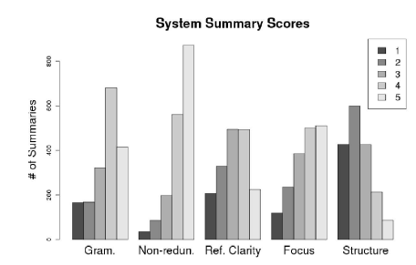
Score Distributions

Slide 49
What is “Readability”? II
Definition subsumes many phenomena, errors
What types of errors do these systems make?
What errors, issues are reflected in the scores?

Slide 50
What is “Readability”? II
Definition subsumes many phenomena, errors
What types of errors do these systems make?
What errors, issues are reflected in the scores?
LQVSumm (Friedrich et al, 2013)
Annotate linguistic “violations” in automatic summaries
TAC2011 data: ~2000 “peer” summaries
Categorize and tabulate
Assess correlation with Readability scores

Slide 51
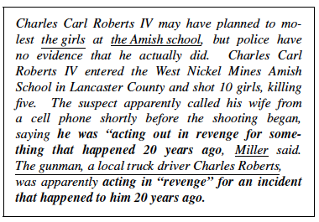
Example
Friedrich et al, 2013, p. 1591, Fig. 1

Slide 52
Violation Categories
Entity mentions:
Affect coreference and readability

Slide 53
Violation Categories
Entity mentions:
Affect coreference and readability
FM_EXPL: First mention w/o explanation
SM+EXPL: Subsequent Mention w/explanation

Slide 54
Violation Categories
Entity mentions:
Affect coreference and readability
FM_EXPL: First mention w/o explanation
SM+EXPL: Subsequent Mention w/explanation
DNP_REF: Definite NP w/o previous mention
INP+REF: Indefinite NP w/ previous mention

Slide 55
Violation Categories
Entity mentions:
Affect coreference and readability
FM_EXPL: First mention w/o explanation
SM+EXPL: Subsequent Mention w/explanation
DNP_REF: Definite NP w/o previous mention
INP+REF: Indefinite NP w/ previous mention
PRN+MISSA: Pronoun w/missing antecedent
PRN+MISSLA: Pronoun w/misleading antecedent

Slide 56
Violation Categories
Entity mentions:
Affect coreference and readability
FM_EXPL: First mention w/o explanation
SM+EXPL: Subsequent Mention w/explanation
DNP_REF: Definite NP w/o previous mention
INP+REF: Indefinite NP w/ previous mention
PRN+MISSA: Pronoun w/missing antecedent
PRN+MISSLA: Pronoun w/misleading antecedent
ACR_EXPL: Acronym w/o explanation

